Slide 1
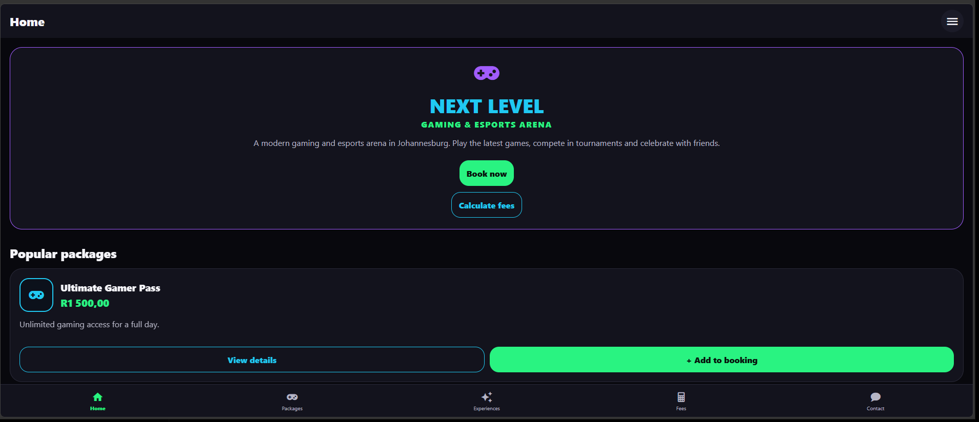
NEXT LEVEL
GAMING & ESPORTS ARENA
TEAM ROSE PRESENTS
Mobile application design, page-by-page
walkthrough and functionality
Group members: Bokang, Gcina, Esihle, Onako and Henoc
Group presentation | 2026
TEAM ROSE
A modern gaming destination designed to help visitors explore, compare and enquire.

Slide 2
PRESENTATION OUTLINE Team member 1
How we will present our mobile application
What we will cover:
All team members
Introduce our mobile application and explain its purpose and who it is designed for.
Explain the homepage layout and the main features available to users, and explain how customers move between sections.
Discuss the About Us screen and the information provided about the business, including its background, vision and mission.
Explain the Packages and Experiences, how customers select them, and how the Calculate Fees screen works out.
Explain the Contact Us screen, the full customer journey, usability, and conclude the presentation.
TEAM MEMBER 1
TEAM MEMBER 2
TEAM MEMBER 3
TEAM MEMBER 4
TEAM MEMBER 5
TEAM ROSE • NEXT LEVEL GAMING & ESPORTS ARENA

Slide 3
01 / PROJECT INTRODUCTION Team member 1
What is Next Level?
The purpose of the website and the experience it is designed to provide
Our project is a mobile application for Next Level Gaming & Esports Arena. It introduces the gaming arena and gives users a convenient way to explore the business and its gaming services directly from their mobile devices.
The application is intended for people who enjoy gaming, friends who want to play together and groups who may be interested in gaming sessions or experiences.
Users can learn about the business, explore available gaming packages and experiences, view service details and prices, add services to their booking selection, calculate estimated fees and find the arena's contact information.
Our aim is to make the application visually exciting and easy to use, with simple navigation and organised information that helps users explore services and prepare a quote request.
TEAM ROSE • NEXT LEVEL GAMING & ESPORTS ARENA

Slide 4
02 / DESIGN DECISIONS Team member 2
Why did we choose this design?
The visual style supports the gaming theme while keeping information easy to read.
We chose a dark black background with dark purple panels because it creates a modern, technology-focused gaming atmosphere that suits the Next Level Gaming & Esports Arena brand.
Right cyan, green and purple are used to make important elements stand out. Cyan highlights headings and secondary buttons, green is used for primary buttons, prices and selected items, while purple adds visual interest through icons and decorative elements.
We used bold headings, round White text is used for headings and important information, while muted grey text is used for descriptions. This creates contrast and makes the information easier to read against the dark background. Each package and experience is displayed in its own card, showing its name, price, description and available actions.
We included clear buttons such as Book now, View details, Add to booking and Calculate fees so users can understand what action to take without having to search through the application.
The navigation is kept consistent throughout the application. Users can access the main sections through the bottom navigation bar, while the hamburger menu provides access to all six pages, including About Us.
We also used familiar icons, readable text and clearly labelled input fields to make the application easier to understand and use.
TEAM ROSE • NEXT LEVEL GAMING & ESPORTS ARENA

Slide 5
03 / WIREFRAMES Team member 2
How the wireframes guided the mobile application
Wireframes are the planning stage that shows where content and controls should appear.
The wireframes helped us plan the layout and structure of each mobile application screen before adding the final colours, typography, icons and styling.
We planned a consistent header at the top of the application, with the page title and hamburger menu, a main content area for the information and features, and a bottom navigation bar for quick access to the main sections.
The Home screen wireframe gives priority to the Next Level branding, a short introduction to the gaming arena and two important actions: Book now and Calculate fees. It also provides shortcuts to popular packages, About Us and Experiences.
The Packages and Experiences screens use separate cards to organise the available services. Each card displays the service name, price and description, with buttons to view more details or add the service to a booking.
The Calculate Fees screen was planned to group the booking selections, customer details and fee summary together, making it easier for users to select services and estimate their total cost.
The final mobile application follows the structure planned in the wireframes. This helps keep the screens organised, maintain consistency and make important actions easy for users to find.
TEAM ROSE • NEXT LEVEL GAMING & ESPORTS ARENA

Slide 6
04 / Mobile application walkthrough TEAM MEMBER 3
Home page — the starting point
The Home page introduces the arena and gives visitors clear routes to the other sections
The top bar displays the Home title and the hamburger menu (☰) in the top-right corner, which opens the full menu.
The hero banner displays NEXT LEVEL GAMING & ESPORTS ARENA and introduces the arena as a modern gaming and esports arena in Johannesburg.
"Book now" opens the Packages section, where customers can start choosing a package.
"Calculate fees" opens the Calculate Fees screen, where customers can estimate a booking cost.
The Popular packages section displays Ultimate Gamer Pass — R1 500,00 and VIP Gaming Experience — R1 500,00, each with View details and + Add to booking.
TEAM ROSE • NEXT LEVEL GAMING & ESPORTS ARENA

Slide 7
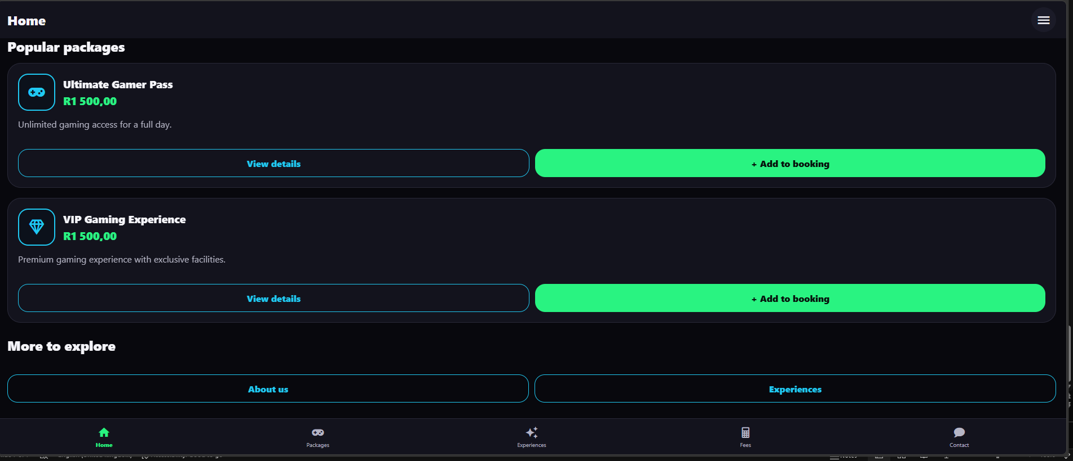
05 / HOME PAGE ACTIONS Team member 3
What do the Home page buttons do?
Each link directs the visitor to a relevant section rather than acting as decoration.
Book now opens the Packages screen, where customers can start choosing a package. In the code: navigate('Packages’)
Calculate fees opens the Calculate Fees screen, where customers can select services and see the estimated total. In the code: navigate('Calculate Fees’)
View details opens the Package Details screen for that specific package, showing its description, price and What’s included list.
+ Add to booking adds that package to the booking selection. The button then changes to Added ✓. Tapping it again removes it. In the code: toggleBooking(item.id)
About us opens the About Us screen, with the history, vision, mission and goals of the arena. In the code: navigate('About Us’)
Experiences opens the Experiences screen, where customers can browse individual activities instead of full packages. In the code: navigate('Experiences')
TEAM ROSE • NEXT LEVEL GAMING & ESPORTS ARENA

Slide 8
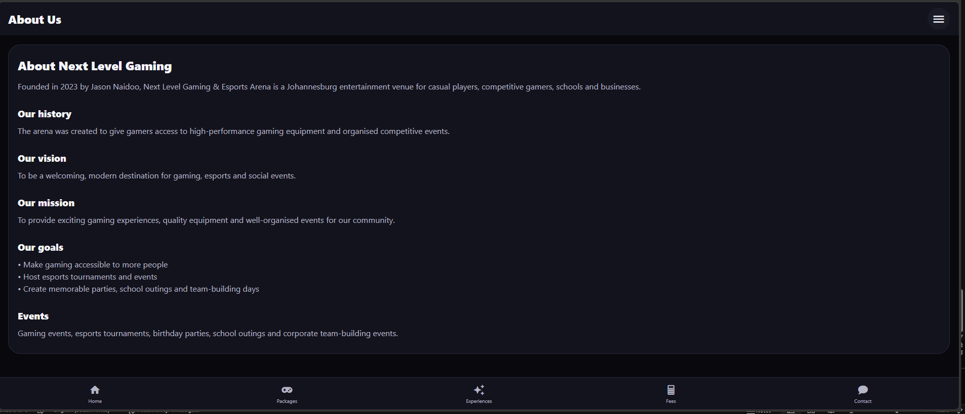
06 / ABOUT US PAGE Team member 3
About Us — introducing the business
This page explains the story and purpose behind Next Level
The About Us screen introduces Next Level Gaming and Esports Arena and explains the idea behind the business.
The supplied app content states that the arena was established in 2023 by Jason Naidoo. It describes the aim of creating a Johannesburg entertainment venue for casual players, competitive gamers, schools and businesses.
The heading "About Next Level Gaming" communicates that this screen gives background information before the customer chooses a service.
The "Our history" section gives visitors more background about the arena and explains that it was created to give gamers access to high-performance gaming equipment and organised competitive events.
The "Our vision" and "Our mission" sections reinforce the welcoming and community purpose of the business. The vision is to be a modern destination for gaming, esports and social events, and the mission is to provide exciting experiences, quality equipment and well-organised events.
The "Our goals" and "Events" sections show what the business wants to achieve and what it offers, including making gaming accessible, hosting tournaments, and offering gaming events, birthday parties, school outings and corporate team-building events.
TEAM ROSE • NEXT LEVEL GAMING & ESPORTS ARENA

Slide 9
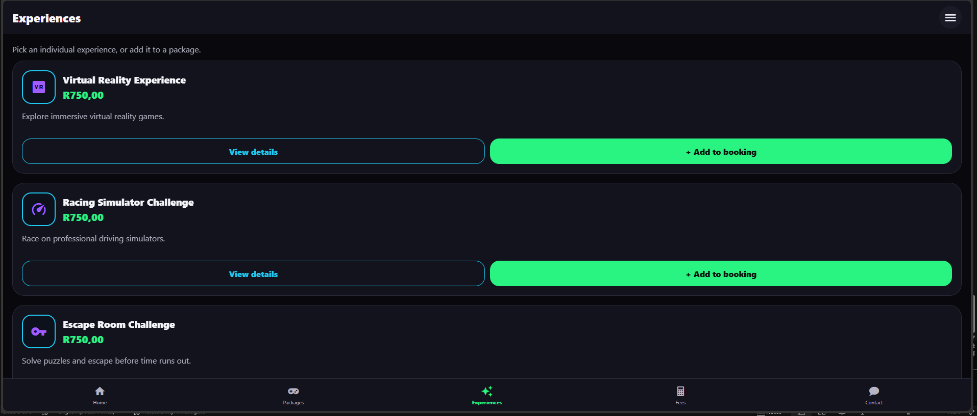
07 / EXPERIENCES PAGE Team member 4
Experiences — choosing how to play
This page presents the gaming options in separate cards so visitors can compare them.
The Experiences screen is designed for customers who want to see the individual gaming activities in more detail. The instruction at the top says: "Pick an individual experience or add it to a package.“
The Virtual Reality Experience card describes an immersive virtual reality activity. The supplied price is R750,00. The description says: "Explore immersive virtual reality games.“
The Racing Simulator Challenge card describes a driving activity on professional simulators. The supplied price is R750,00. The description says: "Race on professional driving simulators.“
The Escape Room Challenge card describes a puzzle activity where customers must solve puzzles and escape. The supplied price is R750,00. The description says: "Solve puzzles and escape before time runs out.“
Each card includes an icon, a title, a price and a short description. This makes the information easier to scan and compare.
The "View details" button opens the details for that experience, and the "+ Add to booking" button adds that experience to the customer's booking selection.
TEAM ROSE • NEXT LEVEL GAMING & ESPORTS ARENA

Slide 10
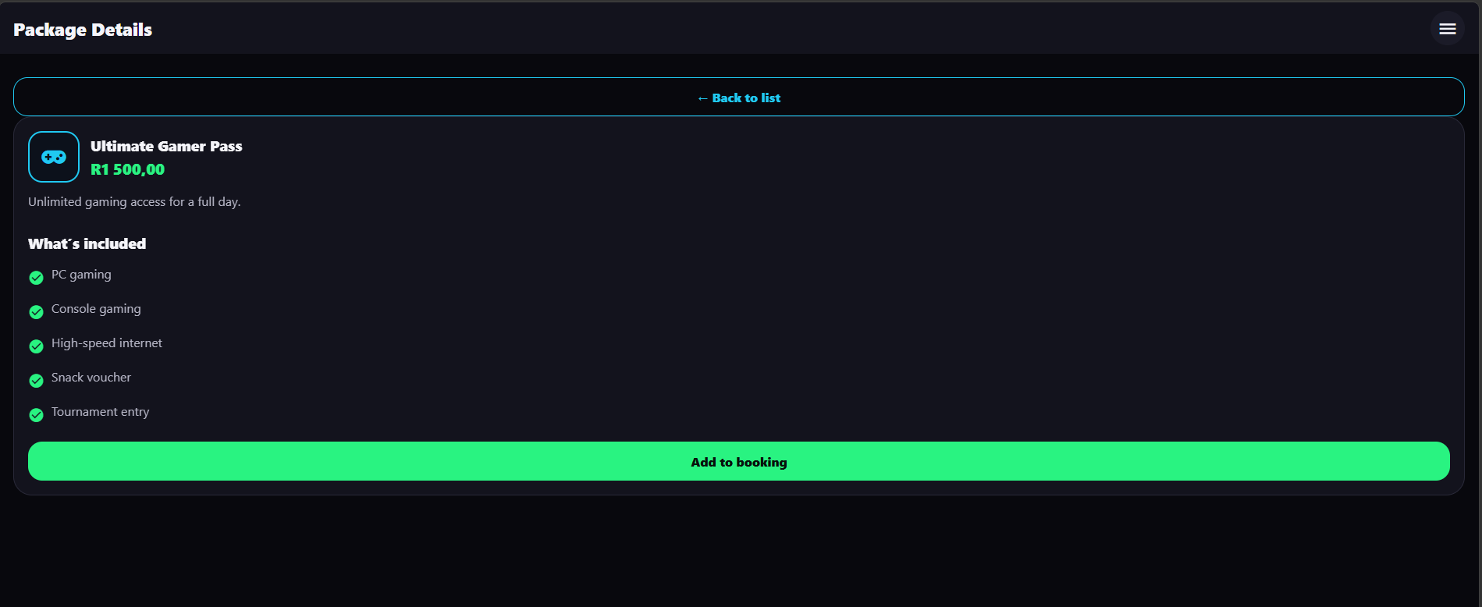
08 / FEATURED PACKAGE PAGE Team member 4
Featured Package — PC Gaming Session
The package page gives visitors more detail about one example experience.
The Package Details screen focuses on the Ultimate Gamer Pass. It explains that the package is intended for customers who want unlimited gaming access for a full day.
The heading shows the package name "Ultimate Gamer Pass" and the price "R1 500,00". This makes the cost clear before the customer reads the rest of the details.
The description states: "Unlimited gaming access for a full day." This communicates that the package is a full-day option, not an hourly session.
The "What's included" list shows exactly what the customer gets: PC gaming, Console gaming, High-speed internet, Snack voucher and Tournament entry. Each item is shown with a green tick.
The "Add to booking" button adds the Ultimate Gamer Pass to the customer's booking selection, so it can be included in the fee calculation.
The "Back to list" button takes the customer back to the Packages list, so they can compare this package with the other packages before deciding.
TEAM ROSE • NEXT LEVEL GAMING & ESPORTS ARENA

Slide 11
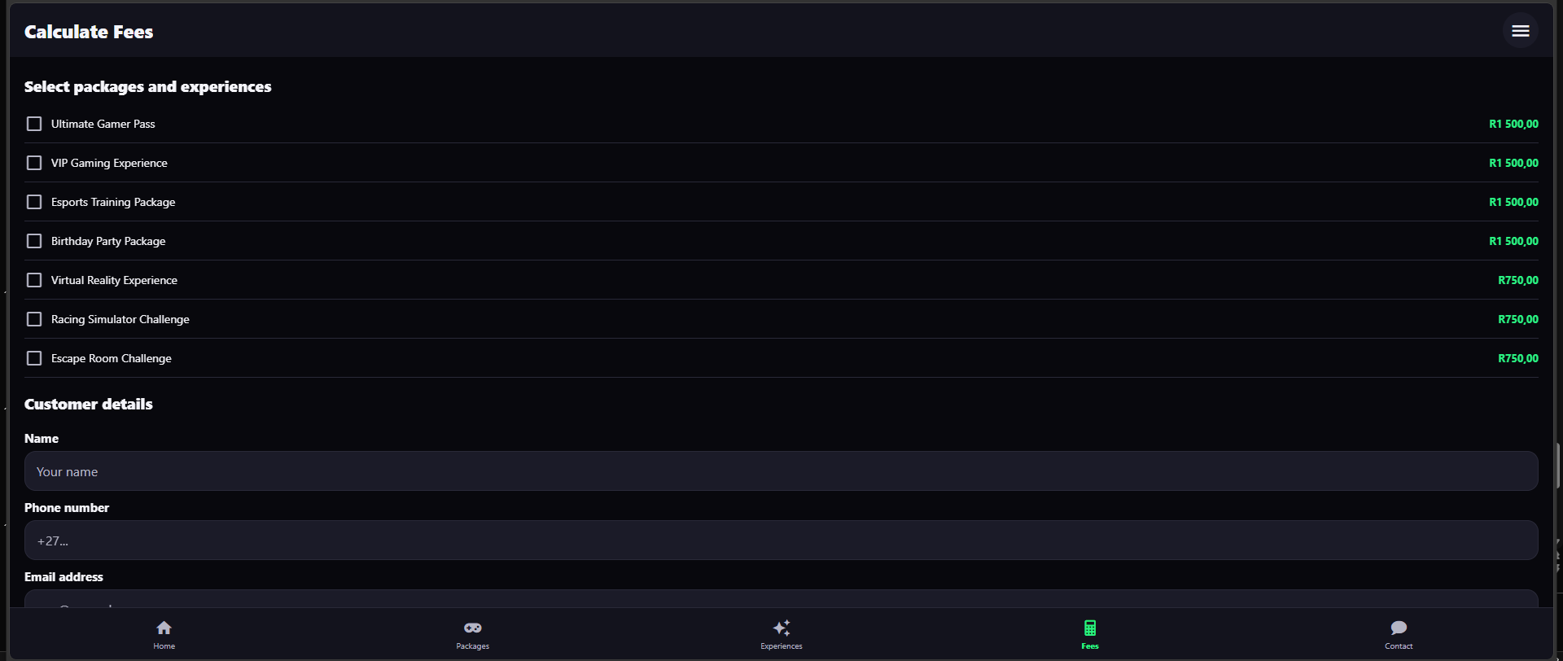
09 / CALCULATE FEES PAGE Team member 5
Calculate Fees
The calculator asks for the booking details and calculates an example estimate
The customer first selects one or more packages or experiences from the checkbox list. The list shows 4 Packages at R1 500,00 each and 3 Experiences at R750,00 each.
The customer then enters their name in the "Name" field. The field shows the placeholder "Your name".
The customer enters their phone number in the "Phone number" field. The field shows the placeholder "+27...".
The customer enters their email address in the "Email address" field. The field shows the placeholder "you@example.com".
When the customer has made a selection, the Fee summary table shows the Subtotal, Discount, VAT (15%) and Estimated total.
TEAM ROSE • NEXT LEVEL GAMING & ESPORTS ARENA

Slide 12
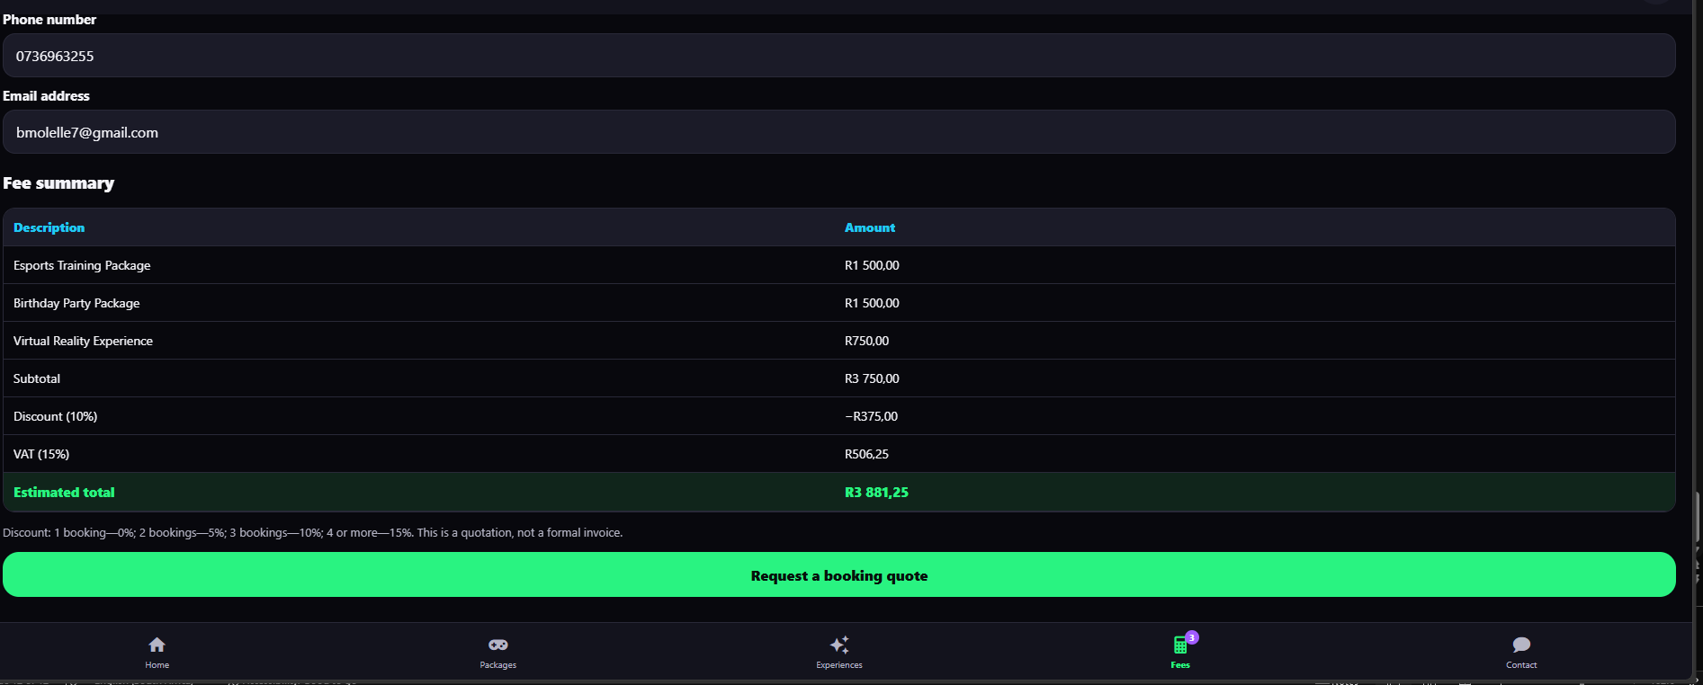
10 / CALCULATOR CONTROLS Team member 5
What does each calculator field and button do?
The form collects the information needed to estimate a booking
"Select packages and experiences" is a checkbox list. The customer ticks a box to add that item to the booking and ticks it again to remove it. Each item shows its name and price.
"Name" is a text field. It records who the quote is for.
"Phone number" is a text field. It records how the team can contact the customer about the booking.
"Email address" is a text field. It records where the quote details can be sent.
"Fee summary" is a result table. It shows each selected item, the Subtotal, the Discount, the VAT (15%) and the Estimated total.
"Request a booking quote" submits the selected items and customer details. The app first checks that the name, phone, email and at least one booking are entered, and then shows a "Quote request ready" message with the estimated total.
TEAM ROSE • NEXT LEVEL GAMING & ESPORTS ARENA

Slide 13
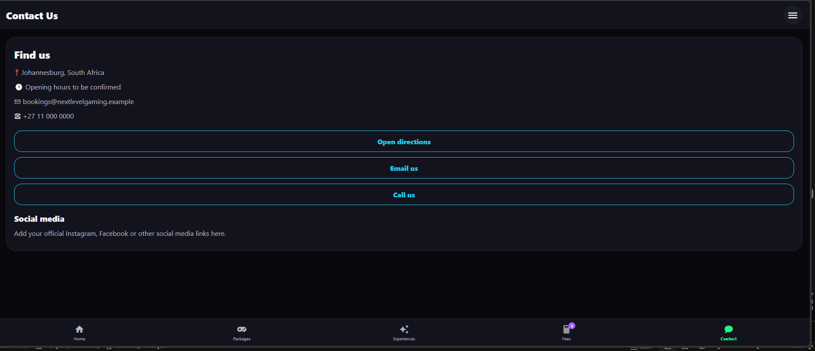
11 / CONTACT PAGE Team member 5
Contact — the next step for enquiries
The contact screen gives customers three direct ways to reach the business
The Contact Us screen shows a "Find us" section with the business details: Johannesburg, South Africa, Opening hours to be confirmed, bookings@nextlevelgaming.example and +27 11 000 0000.
The "Open directions" button opens Google Maps. As shown in the screenshot, it opens a map of Johannesburg, so the customer can see the location of the business and get directions to it.
The "Email us" button opens the customer's email app. It is set to open a new email addressed to bookings@nextlevelgaming.example, so the customer can send an enquiry directly.
The "Call us" button opens the phone link. As shown in the screenshot, the device asks to open Phone Link, so the customer can call the business on +27 11 000 0000.
The "Social media" section is a placeholder for future links. It says: "Add your official Instagram, Facebook or other social media links here.“
The Contact screen is included in the bottom navigation, allowing customers to find the contact section from any screen in the app.
TEAM ROSE • NEXT LEVEL GAMING & ESPORTS ARENA

Slide 14
12/Conclusion Team member 1
The website and mobile application work together to make booking easier.
The project delivered two products for Next Level Gaming and Esports Arena: a website for visitors and a mobile application for customers on their phones.
The website introduces the business and allows visitors to read About Us, browse Experiences, view the Featured Package, estimate a session cost and send an enquiry.
The mobile application allows customers to do the same tasks on a phone, with clear navigation to Home, Packages, Experiences, Fees and Contact.
The Calculate Fees feature helps customers understand the cost before they book. It shows the selected items, the multi-booking discount, the VAT of 15% and the estimated total.
The Contact features help customers take the next step. The website allows visitors to send an enquiry, and the app allows customers to open directions, email the business or call the business directly.
TEAM ROSE • NEXT LEVEL GAMING & ESPORTS ARENA

Slide 15
References
Expo (n.d.) Expo Documentation. [online] Available at: https://docs.expo.dev/
2. Meta (n.d.) React Native Documentation. [online] Available at: https://reactnative.dev/
3. React (n.d.) React Documentation. [online] Available at: https://react.dev/
4. W3C (2024) Web Content Accessibility Guidelines (WCAG) 2.2. [online] Available at: https://www.w3.org/TR/WCAG22/
5. Pictogrammers (n.d.) Material Design Icons. [online] Available at: https://pictogrammers.com/library/mdi/

